Slide 1



Sales
Analysis

Slide 2

Problem Statement:
Sales management has gained importance to meet increasing competition and the need for improved methods of distribution to reduce cost and to increase profits. Sales management today is the most important function in a commercial and business enterprise.
Do ETL: Extract-Transform-Load some Amazon dataset and find for me Sales-trend -> month-wise, year-wise, yearly_month-wise
Find key metrics and factors and show the meaningful relationships between attributes. Do your own research and come up with your findings.

Slide 3

"This analysis provides an in-depth look at Amazon's sales performance across different regions and countries. We will explore total sales, units sold, and total profit to identify top-performing areas."
Objectives:
•Understand the factors of sales as per cost,profit and revenue
•Identify trends and patterns for yearly,monthly and yealy-monthly.
•finds the key insights from the data regarding sales.

Slide 4
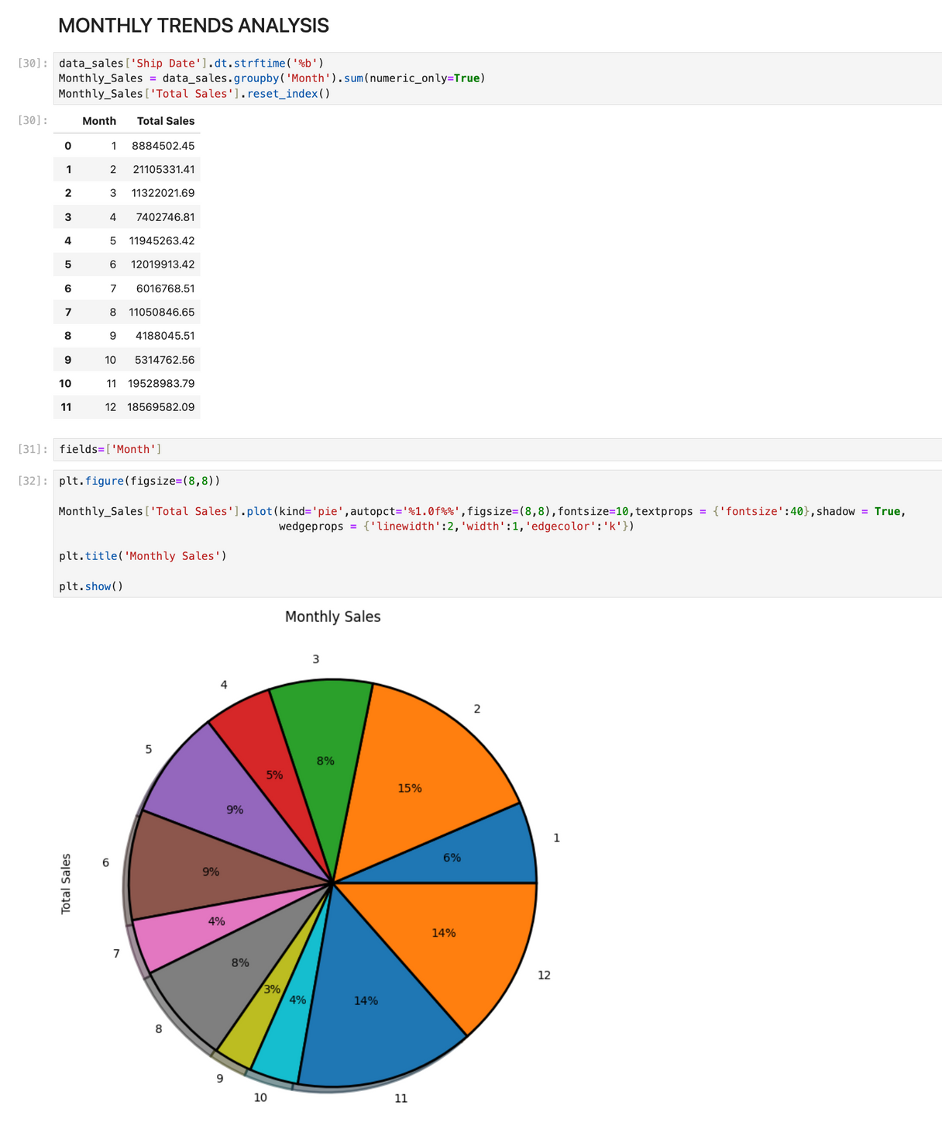
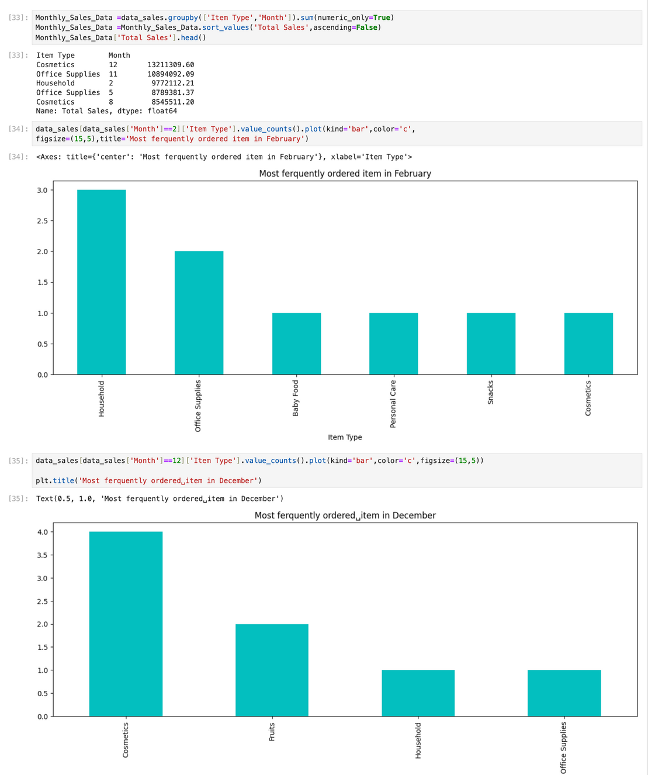

Slide 5
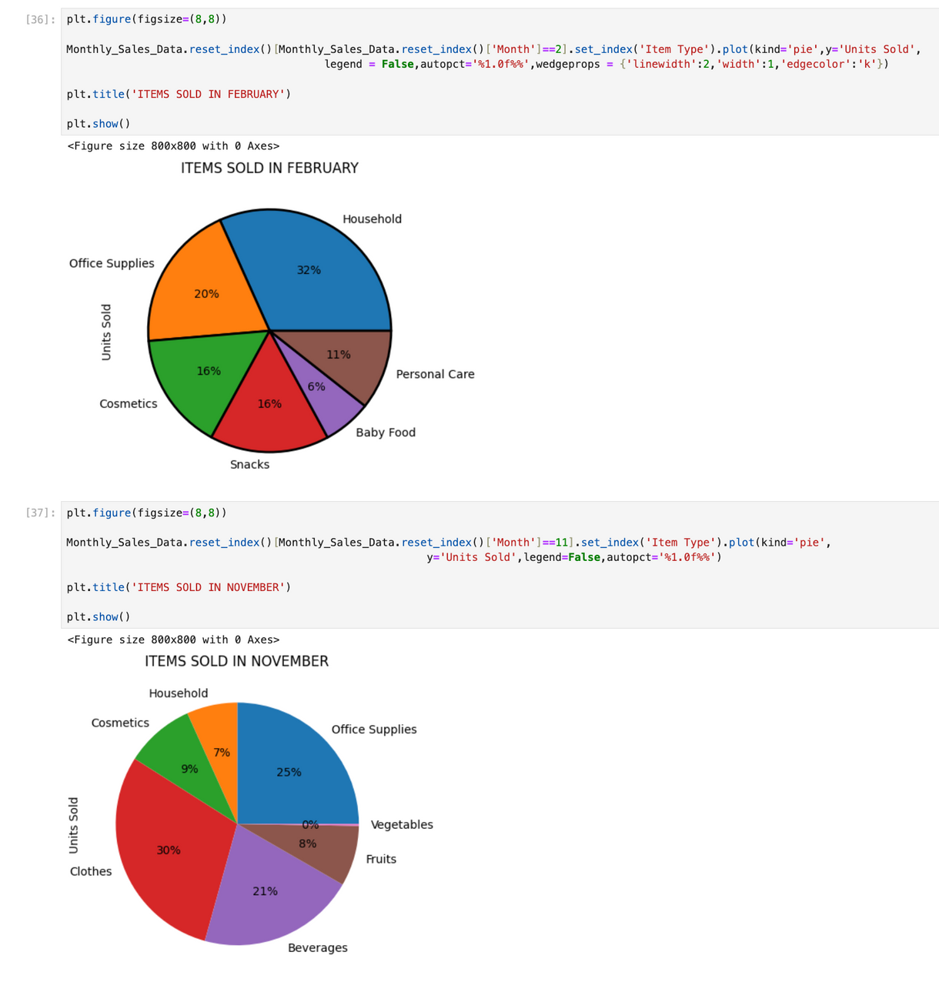
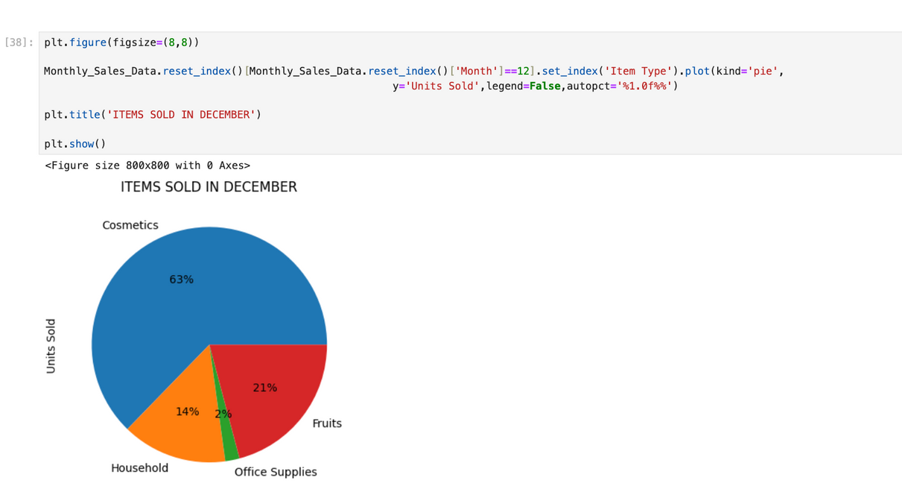

Slide 6
MONTHLY TRENDS :
February has Household products it is alomost 32% of total Items Sold in that
Month
November has Office Supplies it is almost 30% pf Total Items Sold in that Month
December has Cosmestics it is almost 63% of Total Items Sold in that Month

Slide 7
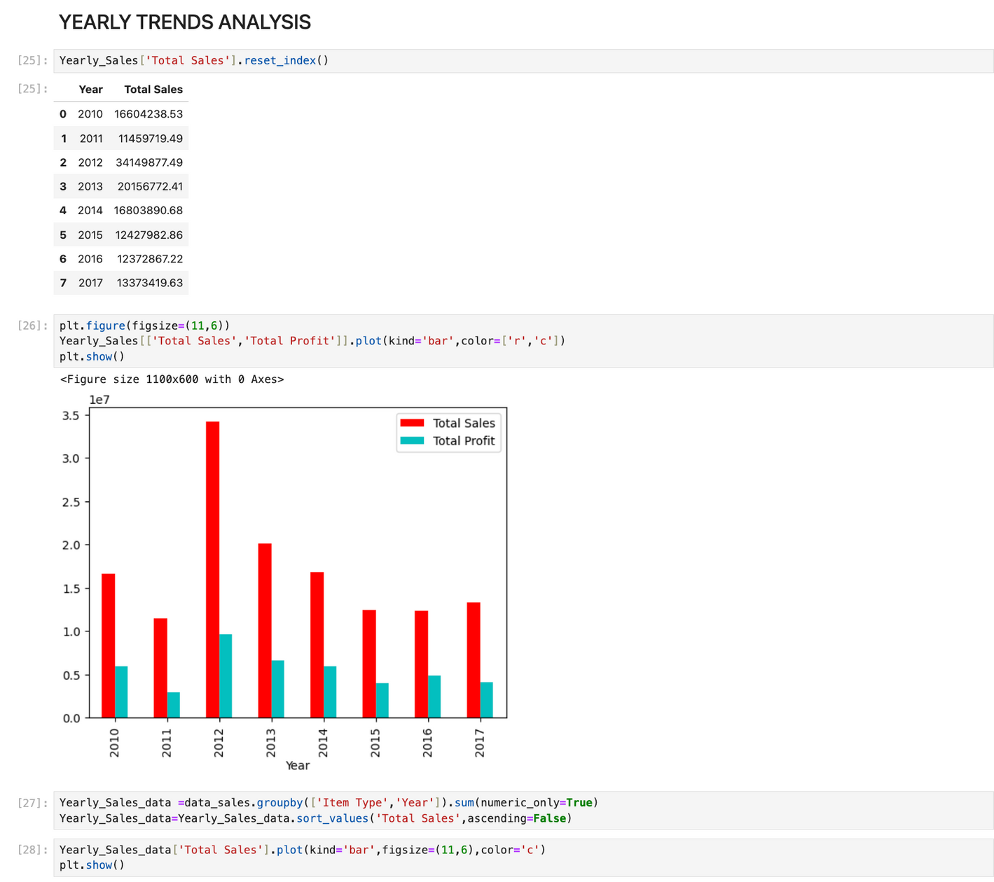
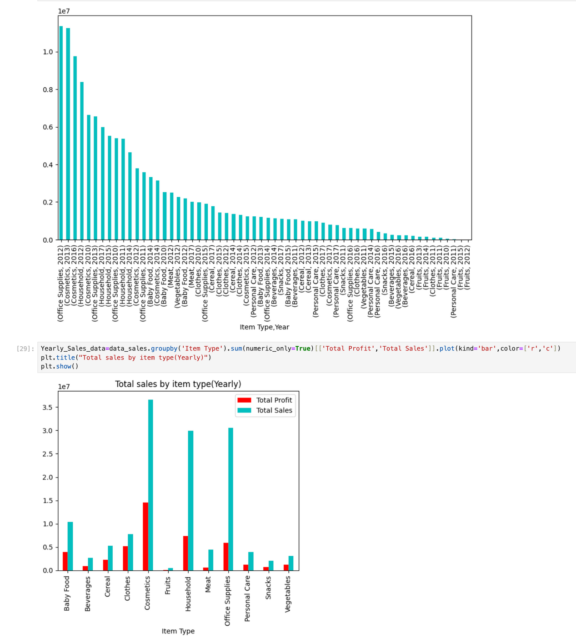

Slide 8
YEARLY TRENDS :
YEARLY ITEMS SOLD
YEAR 2012:
Most sales from office supplies items with household items.
Most units sold are Office items.
Most profitable items are office supplies and household
YEAR 2013:
Most Sales from cosmestics items and office supplies.
Most units sold are cosmestics and fruits.
Most profitable items are cosmestics and office supplies.
YEAR 2011:
Most sales from House hold items and office supplies
Most units sold are Beverages and fruits.
Most profitable items are Household.

Slide 9
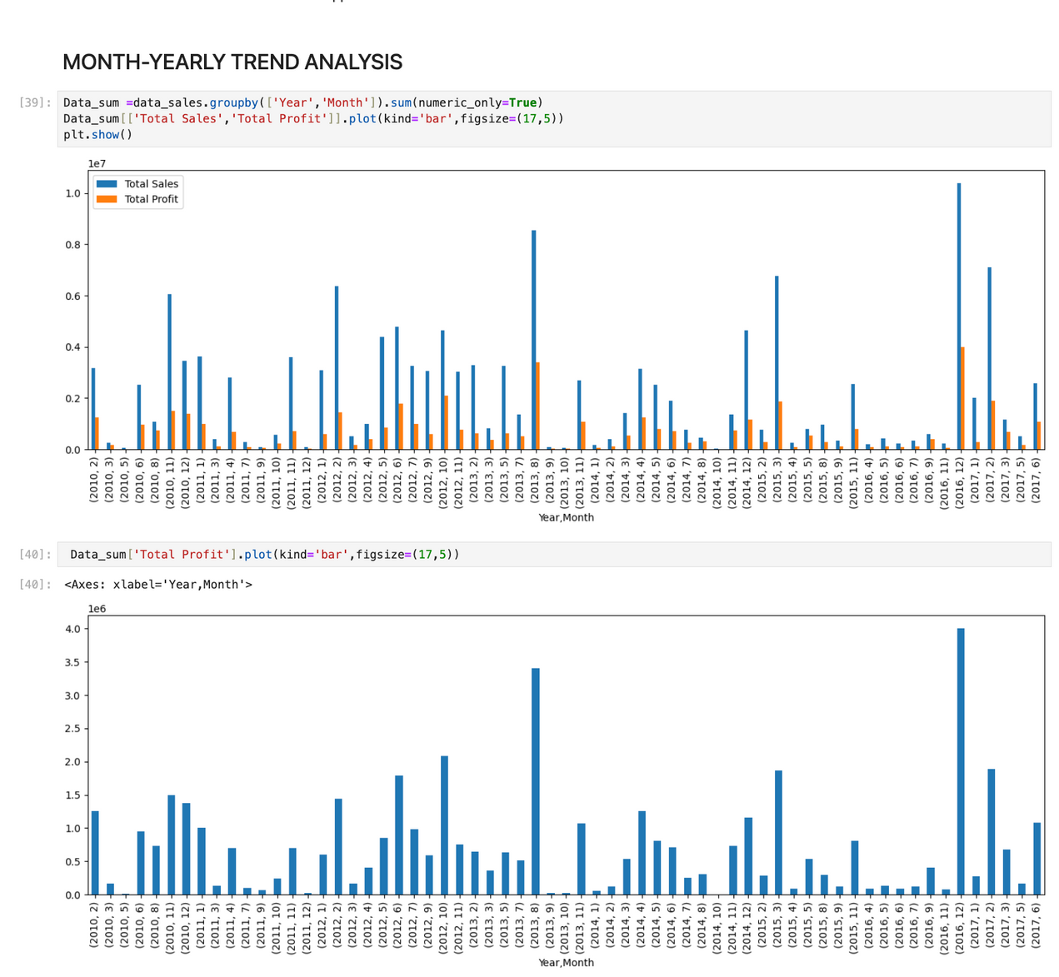
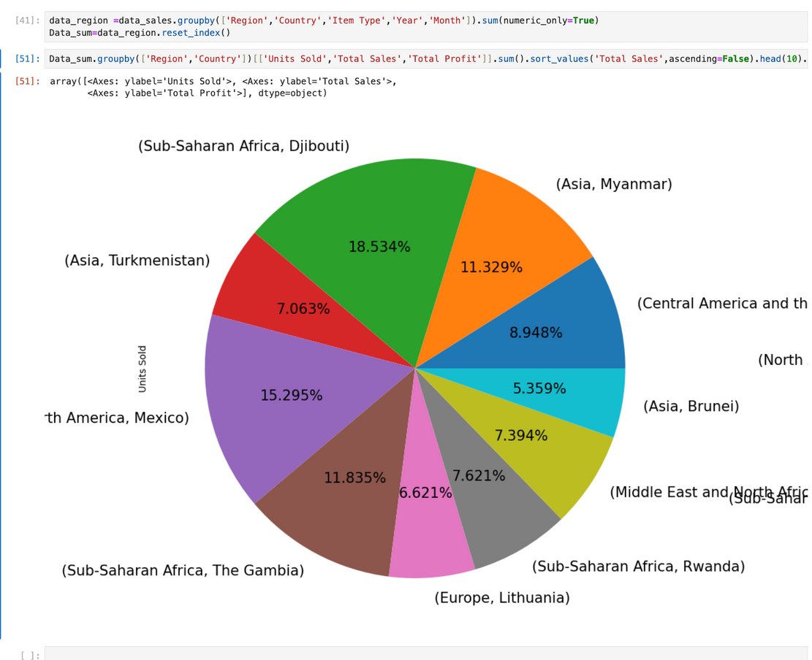

Slide 10
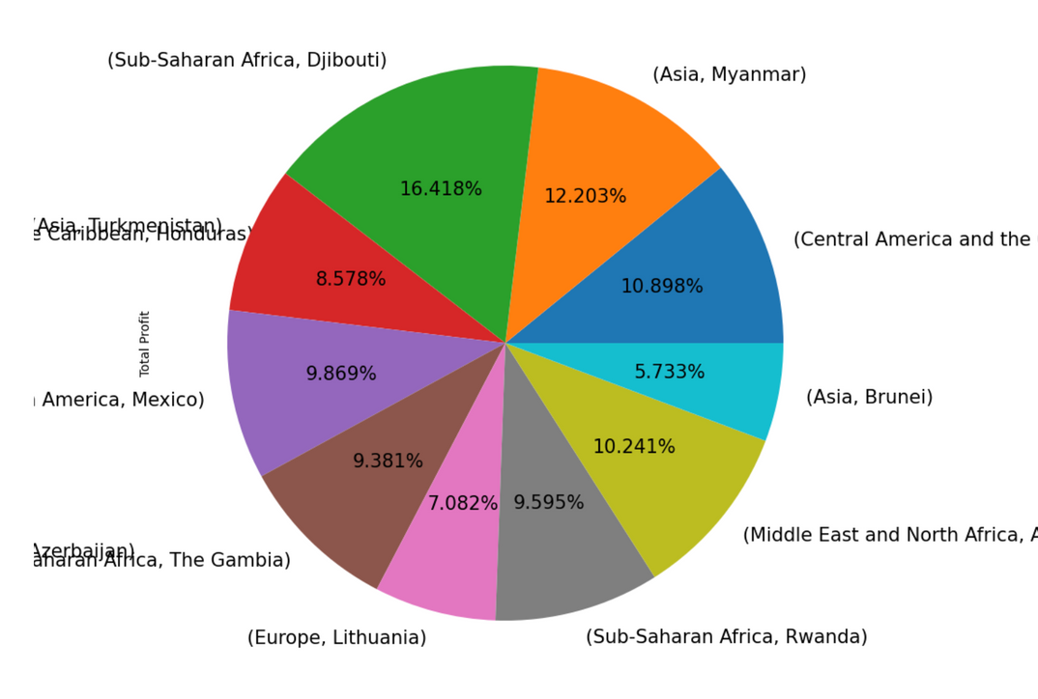
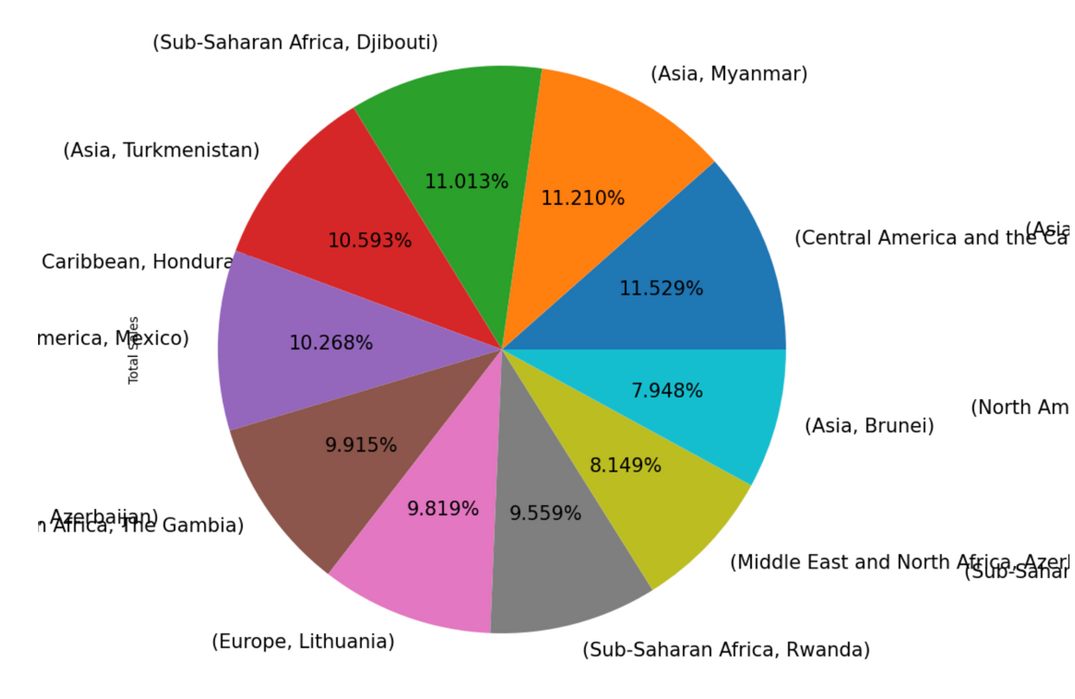

Slide 11
MONTH-YEARLY TREND :
Highest sales and profit in december 2016
Second highest is in august 2013.
Maximum Units sold in december 2016.
Minimum units sold in October 2014.
Maximum profit is from Sub-Saharan Africa,Asia.
Maximum Sales from Sub-Saharan Africa,Asia.

Slide 12

THANK YOU

